Slide 1
M.SAJETHA
Final Project
3/21/2024 Annual Review

Slide 2
PROJECT TITLE
Weather Prediction using CNN

Slide 3
AGENDA
The aim of a weather prediction project using Convolutional Neural Networks (CNNs) is to enhance forecasting accuracy by analyzing vast amounts of meteorological data and patterns. Its agenda includes leveraging CNNs to recognize complex spatial and temporal relationships in weather data, thereby improving predictive capabilities for various atmospheric phenomena. Ultimately, the goal is to provide more reliable and timely forecasts to mitigate risks associated with severe weather events.

Slide 4

PROBLEM STATEMENT
The problem statement for a weather prediction project using Convolutional Neural Networks (CNNs) involves developing a model capable of accurately forecasting various meteorological parameters, such as temperature, precipitation, and wind patterns, based on historical and real-time weather data.
The challenge lies in leveraging CNN architectures to effectively capture spatial and temporal dependencies within the data, addressing issues like data heterogeneity, non-linear relationships, and dynamic atmospheric conditions to enhance the precision and reliability of weather predictions.

Slide 5

PROJECT OVERVIEW
This weather prediction project utilizing Convolutional Neural Networks (CNNs) aims to revolutionize forecasting accuracy by harnessing the power of deep learning techniques. Leveraging vast datasets of historical and real-time meteorological information, the project seeks to develop a robust CNN model capable of accurately predicting various weather parameters, including temperature, precipitation, humidity, and wind patterns
Visual representation:
The weather prediction project utilizing Convolutional Neural Networks (CNNs) is structured around several key phases. Initially, historical and real-time meteorological data are gathered from diverse sources, including weather stations, satellites, and sensors. Following this, the data undergoes rigorous preprocessing to handle missing values, normalize features, and partition into training, validation, and testing subsets.

Slide 6
OBJECTIVE:
Develop a Convolutional Neural Network (CNN) model tailored for weather prediction tasks.
Improve forecasting accuracy for meteorological parameters such as temperature, precipitation, humidity, and wind patterns.
Capture complex spatial and temporal relationships within weather data through efficient CNN architecture.
Enhance reliability and timeliness of weather forecasts to facilitate better preparedness and resilience.
Leverage deep learning techniques to optimize model performance and address challenges in weather prediction.

Slide 7
YOUR SOLUTION AND ITS VALUE PROPOSITION
Enhanced Accuracy: By utilizing CNNs and advanced deep learning techniques, the solution offers improved accuracy in weather forecasting compared to traditional methods. This accuracy enables better decision-making and planning for individuals, businesses, and governments.
Timely Predictions: The real-time capabilities of the solution ensure timely delivery of weather forecasts, allowing users to stay informed about changing weather conditions and take appropriate actions in advance.
Customized Forecasting: The flexibility of CNN architectures allows for customization according to specific meteorological parameters and geographical regions, providing tailored forecasts that meet the unique needs of users.
Scalability and Integration: The solution is designed to scale efficiently and integrate seamlessly with existing weather prediction systems and applications, enhancing their capabilities without significant infrastructure changes.

Slide 8
The Wow Factor in Your Solution
Deep Learning Innovation: By integrating advanced deep learning techniques, particularly CNNs, we're pushing the boundaries of traditional weather prediction methods. Our solution harnesses the complex patterns and dependencies within meteorological data, allowing for more accurate and reliable forecasts.
Real-Time Precision: We offer real-time weather forecasts with unprecedented precision. Through our CNN-based approach, we can analyze vast amounts of data quickly and efficiently, providing users with up-to-the-minute insights into changing weather conditions.
Tailored Forecasting: Our solution doesn't just provide generic weather predictions; it offers customized forecasts tailored to specific parameters and geographical regions. This level of customization ensures that users receive highly relevant and actionable insights, whether they're planning a picnic or managing a large-scale agricultural operation.
Seamless Integration: We've designed our solution to seamlessly integrate with existing weather prediction systems and applications. This means that users can leverage our advanced forecasting capabilities without the need for extensive infrastructure changes or disruptions to their current workflows.

Slide 9
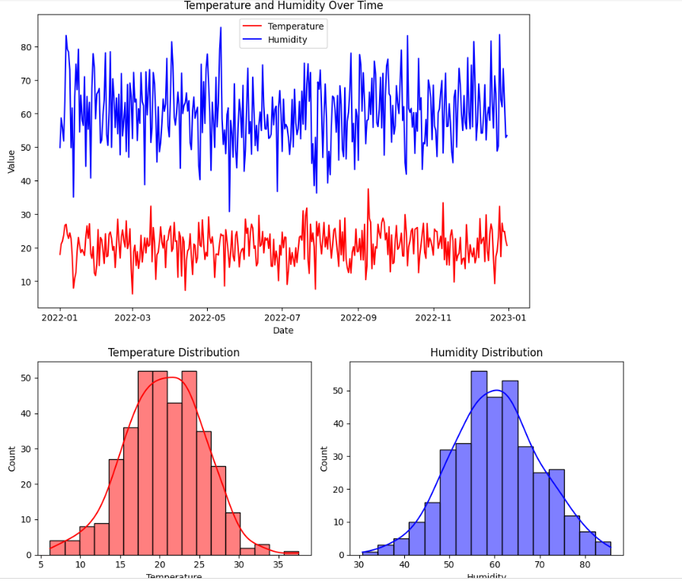
RESULTS
WEATHER PREDICTION

Slide 10
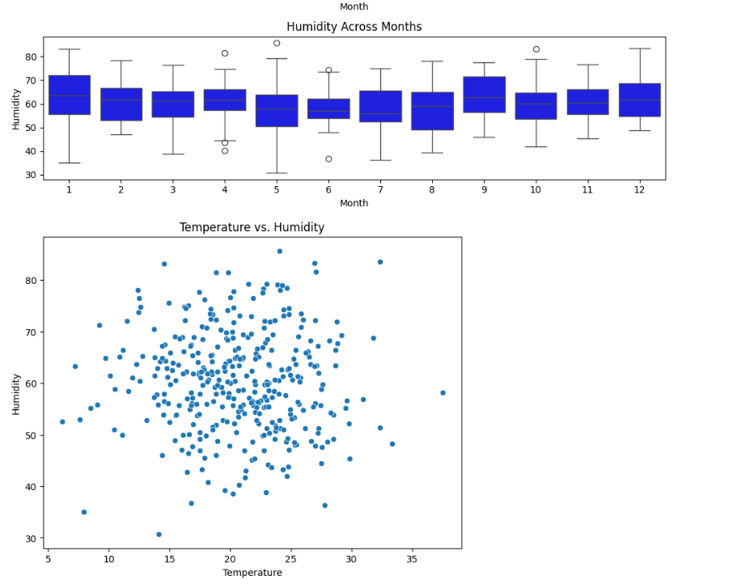
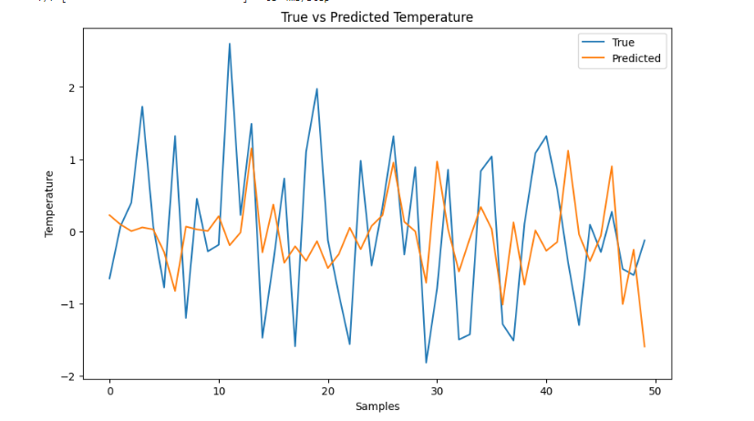
Results
DRIVE LINK:
https://colab.research.google.com/drive/1-syetRpdyZrh_qf8y2Y1y2m4tXmgYCFo#scrollTo=58We7TVeiTbu

Slide 11
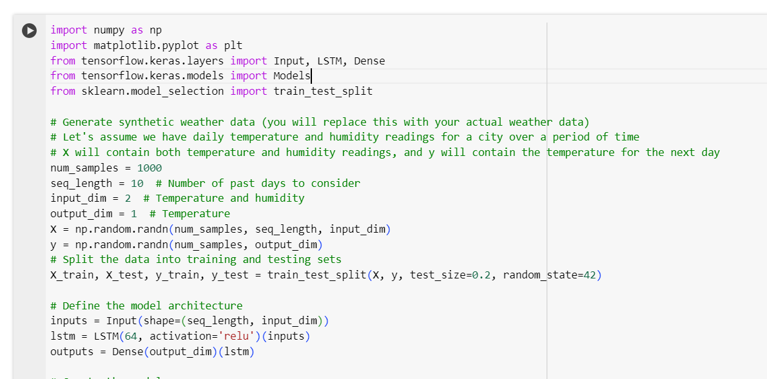
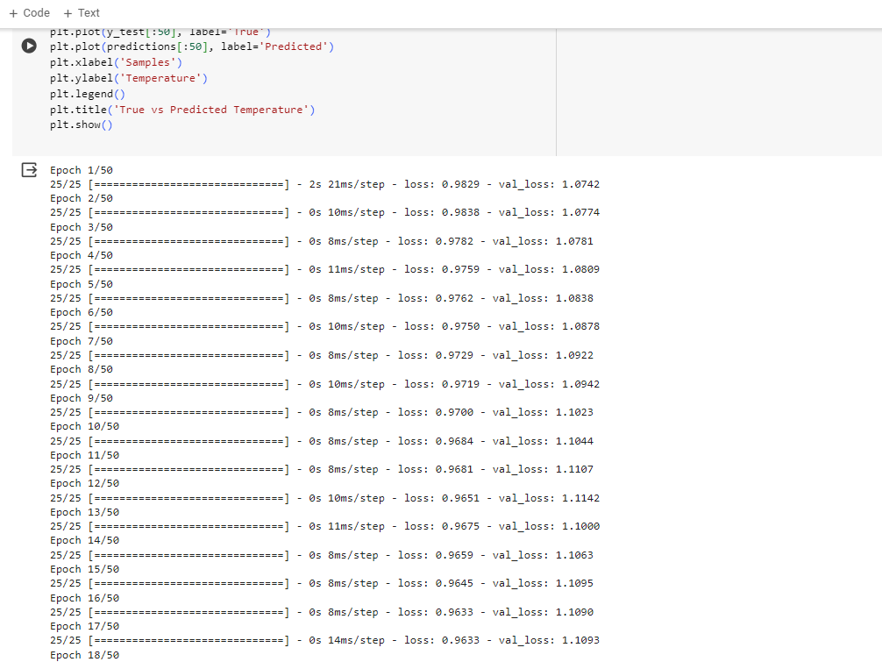
Accuracy of the model

